Slide 1

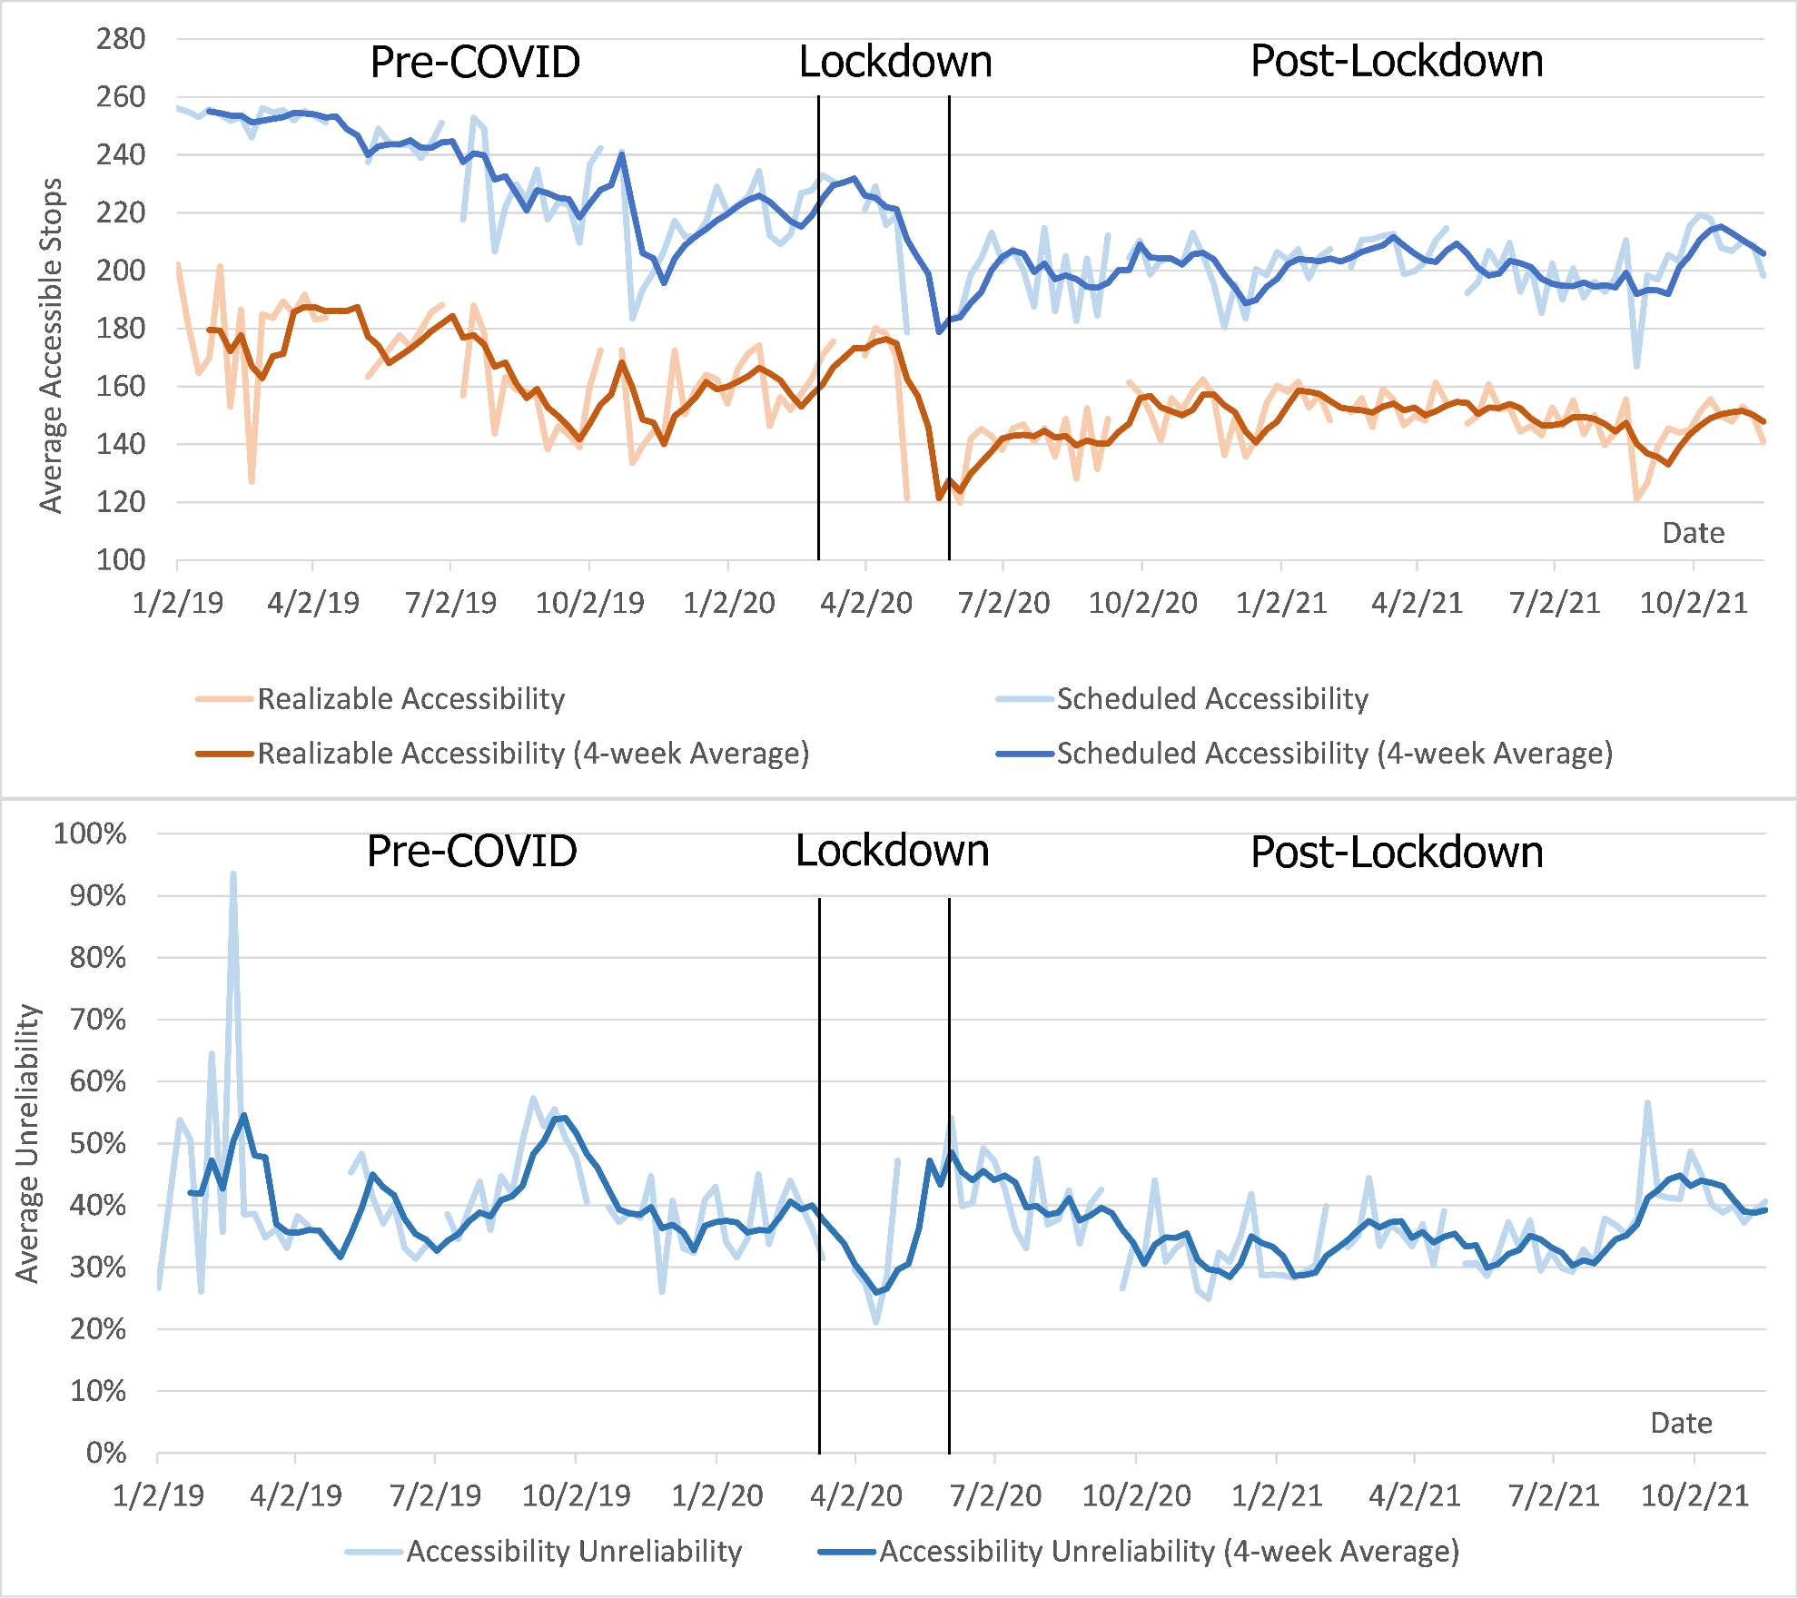
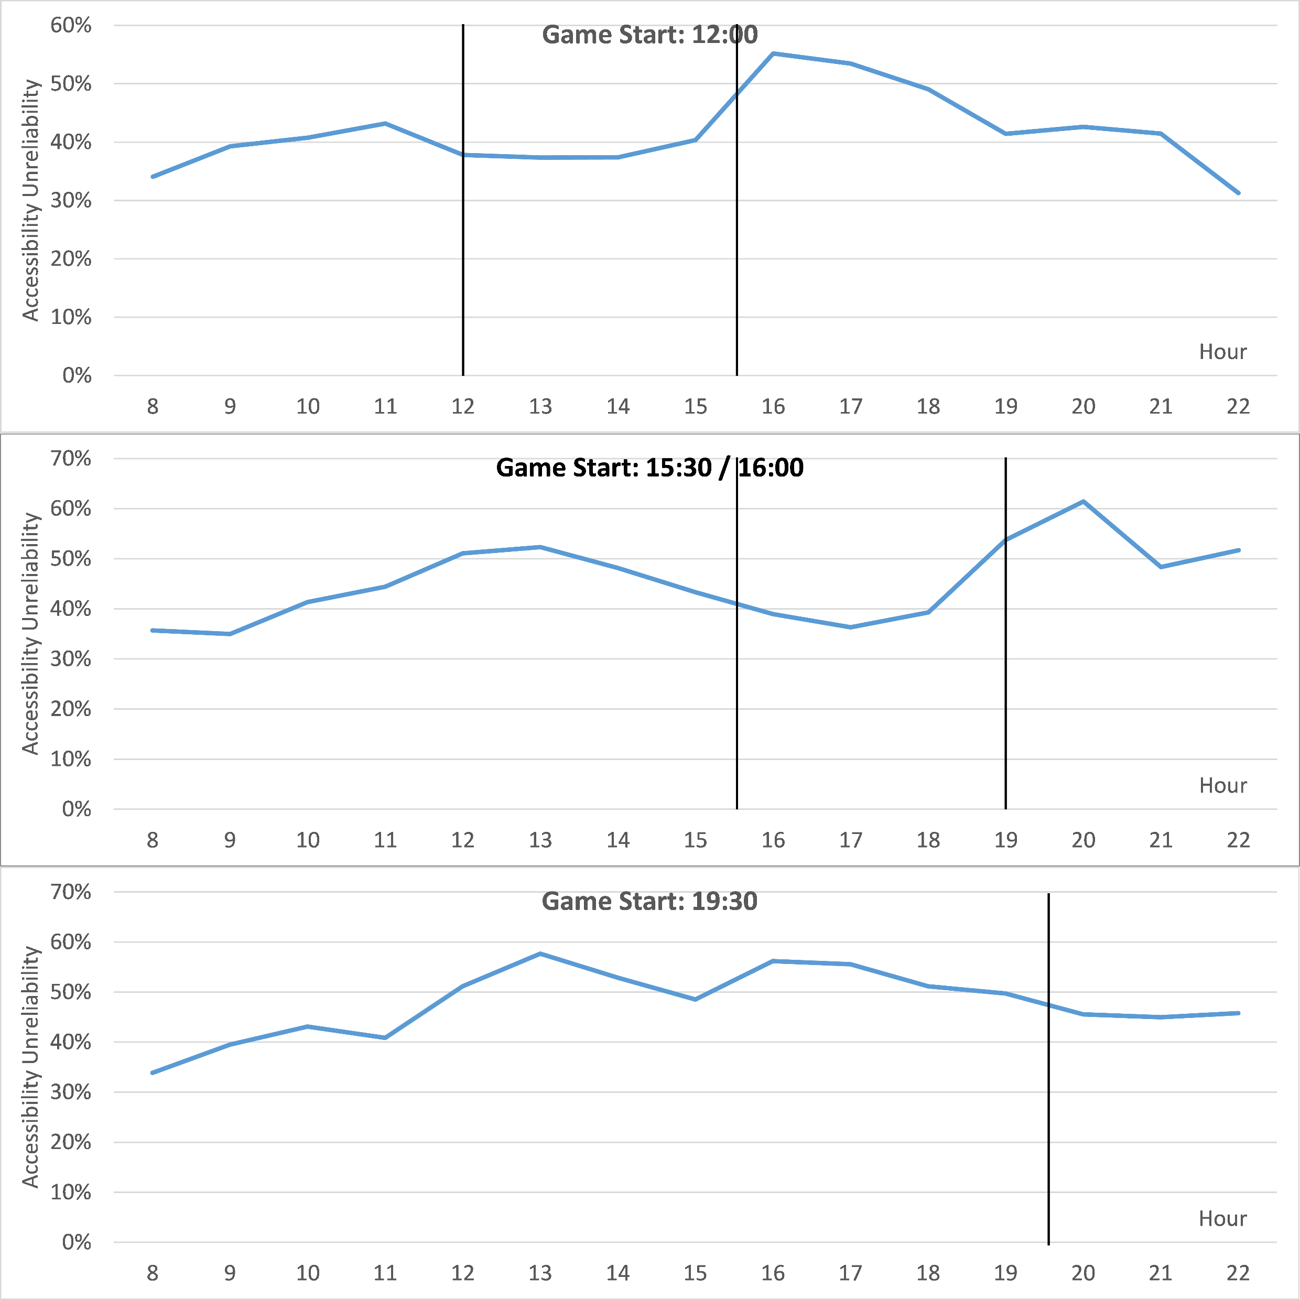
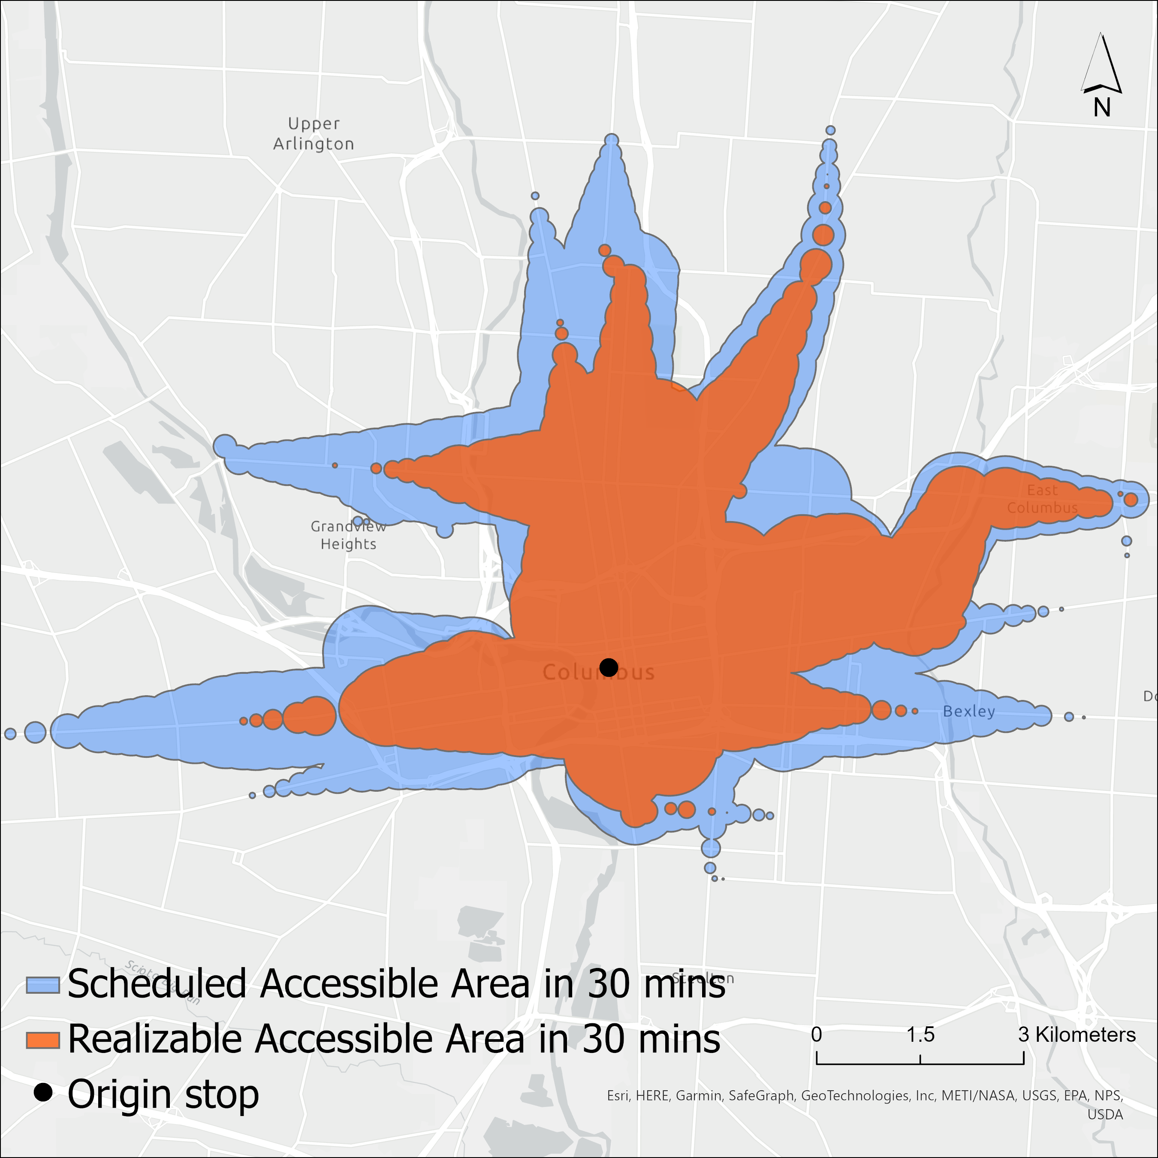
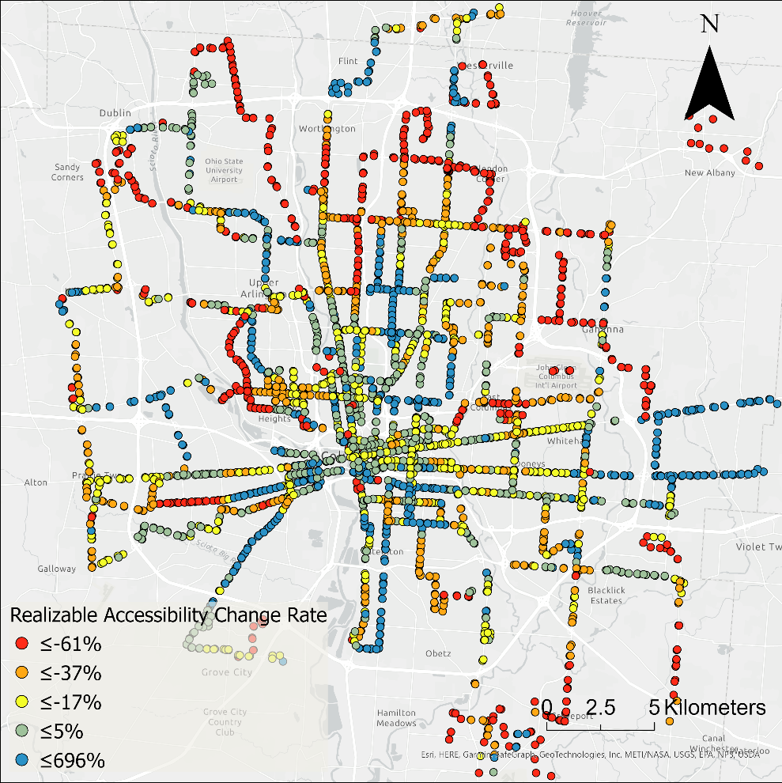
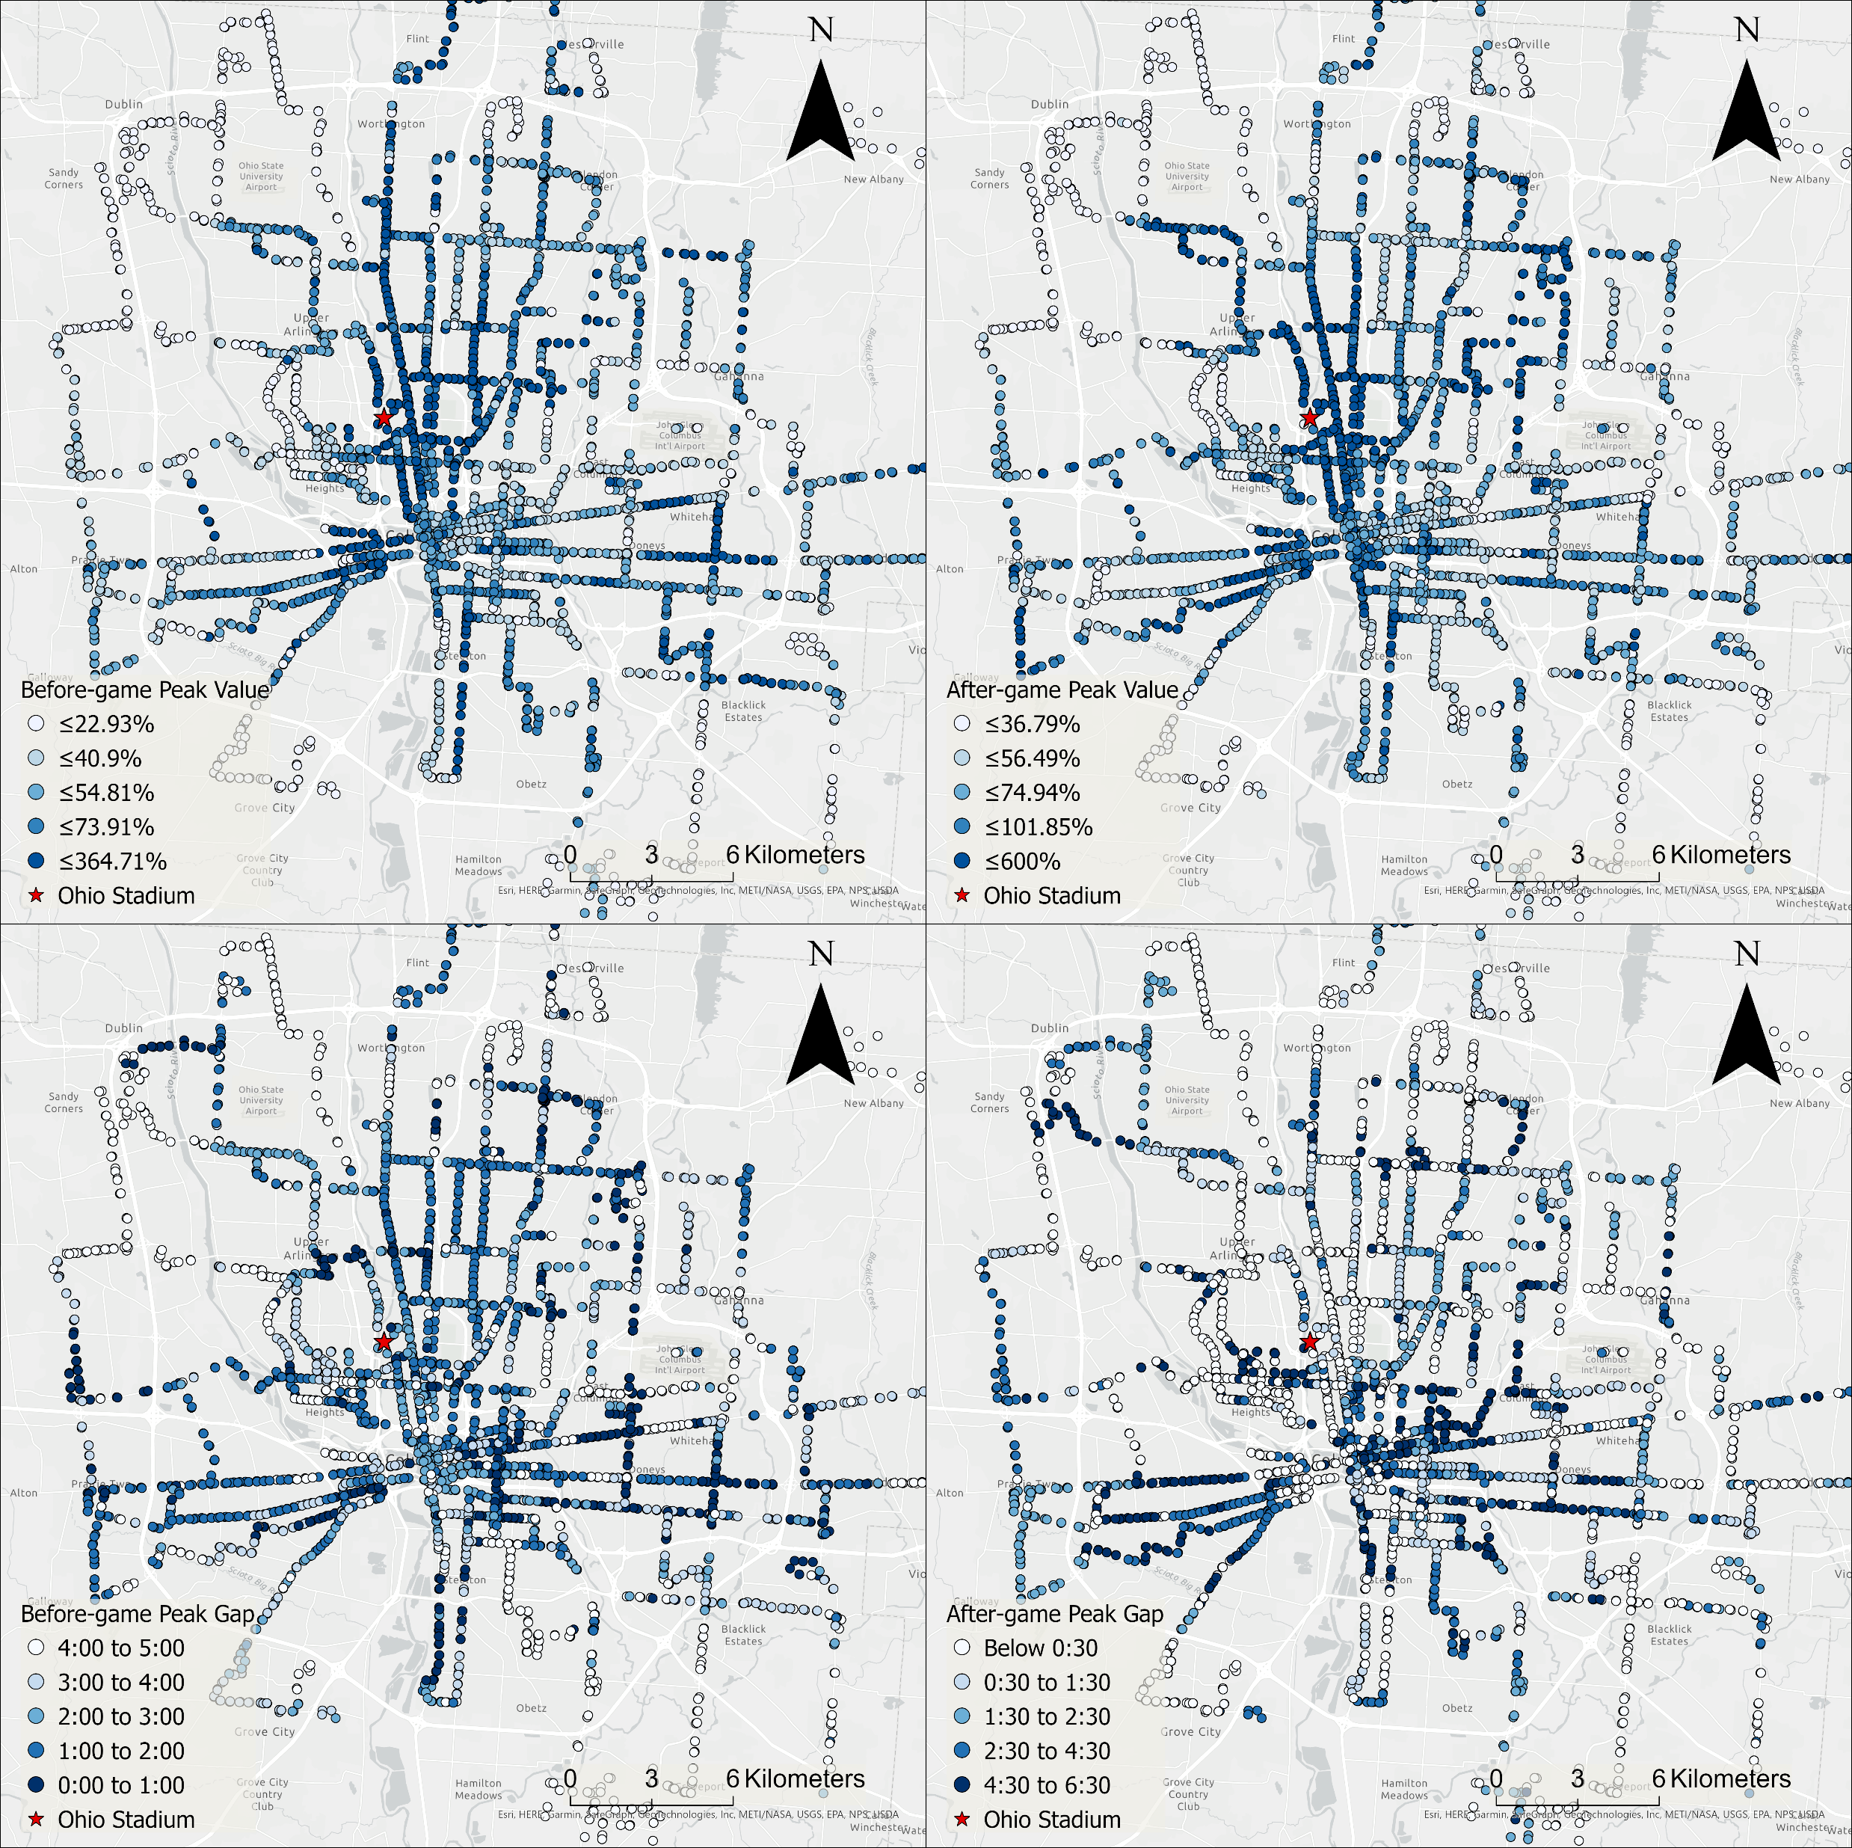
Measuring the Impacts of Disruptions on Public Transit Accessibility and Reliability
Luyu Liu, Adam Porr, Harvey J. Miller
Department of Geography, The Ohio State University
Background
Short-term Disruption: Ohio State Football Game
Long-term Disruption: COVID-19 Pandemic
Public transit systems are at higher risk of system degradation and decreased reliability due to external disruptions, making resilience (maintaining functions during a disruption) a crucial assessment.
About 100k people arrived at Ohio Stadium per game in 2019, creating heavy traffic and acute disruption.
Before/after-game unreliability peaks: Most game days had two periods of increased unreliability before and after the game, due to traffic to and from the stadium.
COVID-19 has persistent and chronic negative impacts on public transit accessibility and accessibility reliability.
Realizable and scheduled accessibility 2019 – 2021
Both accessibility measures rapidly declined in May 2020
Scheduled accessibility declined faster
Accessibility stayed low during 2021
Data & Method
We calculate two space-time prism-based measures using GTFS-RT data: realizable real-time accessibility (achievable by users with delays) and scheduled accessibility.
We also calculate accessibility unreliability as the deviation between realizable and scheduled accessibility to measure the reliability of delivered accessibility.
The positions of the peaks are shifting along with the changing game start time
Accessibility unreliability 2019 – 2021
Accessibility unreliability during the lockdown first declined and then increased
The 19:30 game did not have an after-game peak because it extended past normal operation hours
Change rate of accessibility during COVID
Most service cuts were in suburb and urban outskirts, resulting plunging accessibility in those areas
Downtown area suffered least from COVID-19; some neighborhoods even experienced increase in reliability due to better traffic condition
Highest unreliability at each stop
Football games create large amount of traffic and unreliability around the event location
Conclusions
Schedule-based accessibility is unreliable
OSU football games significantly affect public transit performance
COVID-19 have persistent negative impacts on both accessibility and reliability
Unreliability should be considered with other measures, like accessibility, to understand overall system performance
Unreliability: difference between scheduled and realizable accessible area

